Slide 1
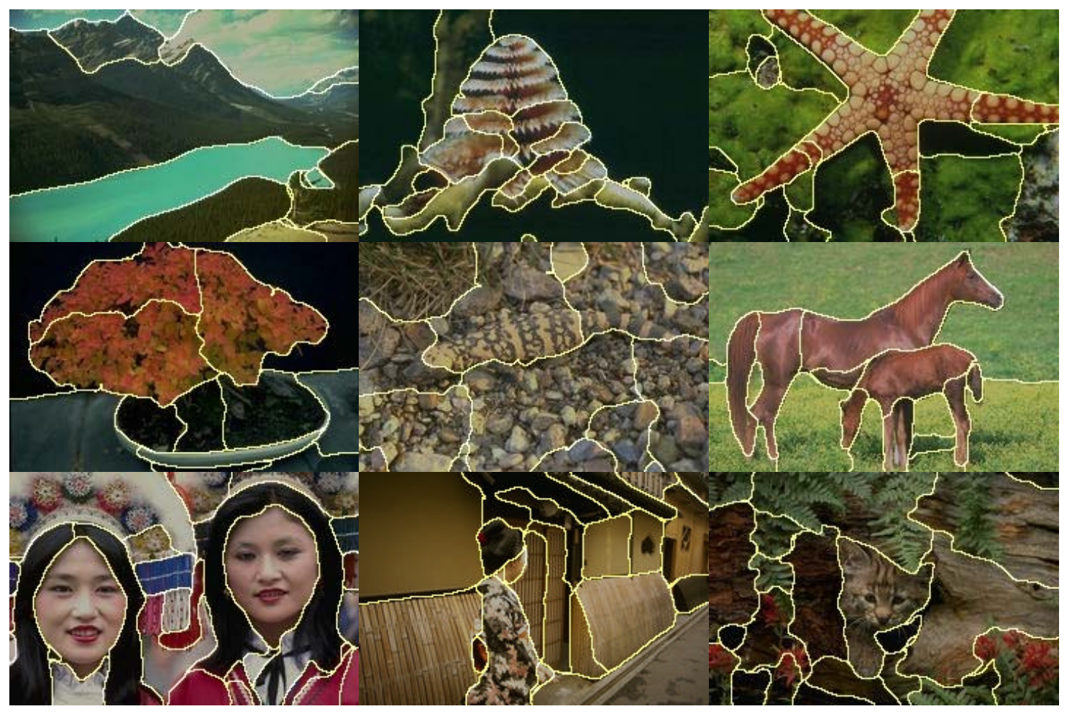
图像分割的评价 Evaluation of Image Segmentation Ning Tang

Slide 2
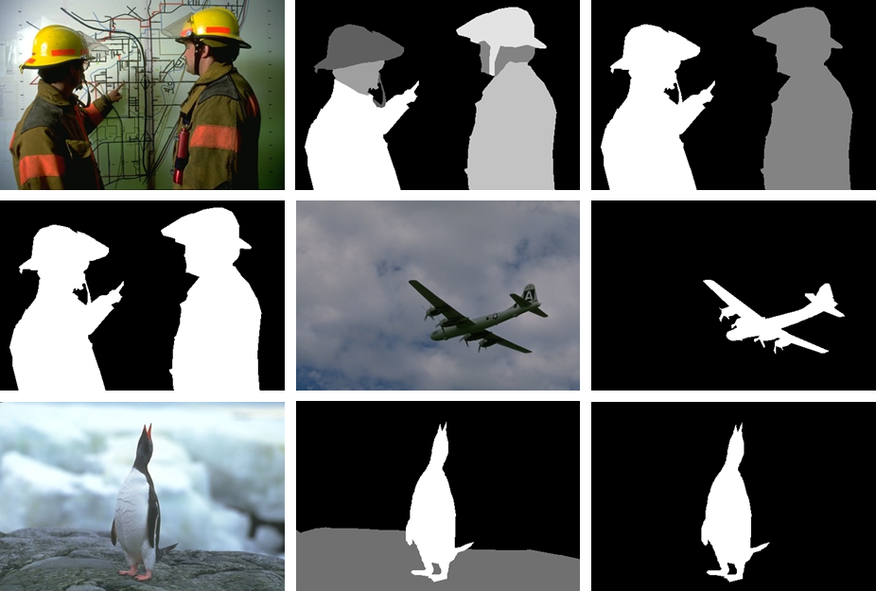
Evaluation of Image Segmentation
Compare segmentation result with ground-truth
segmentation
result
ground-truth

Slide 3
Evaluation of Image Segmentation
Compare segmentation result with ground-truth
How？

Slide 4
Evaluation of Image Segmentation
Compare segmentation result with ground-truth
How？
Evaluation Measure

Slide 5
Evaluation Measures
F-measure
Segmentation Covering
Probabilistic Rand Index (PRI)
Normalized Probabilistic Rand Index (NPRI)
Variation of Information (VoI)
Global Consistency Error (GCE)
Boundary Displacement Error (BDE)
… …

Slide 6
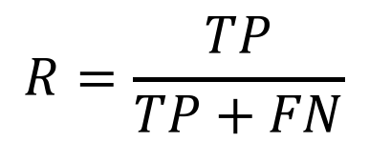
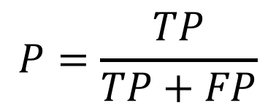
F-measure
A combination of precision and recall leads to the F-measure.
Actual class
Predicted class
$$P=\frac{TP}{TP+FP}$$
Yes
No
Yes
True positive
False negative
$$R=\frac{TP}{TP+FN}$$
No
False positive
True negative

Slide 7
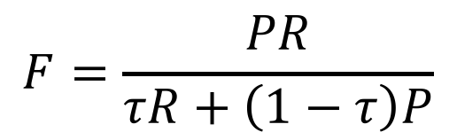
F-measure
A combination of precision and recall leads to the F-measure.
$$F=\frac{PR}{τR+\left(1−τ\right)P}$$

Slide 8
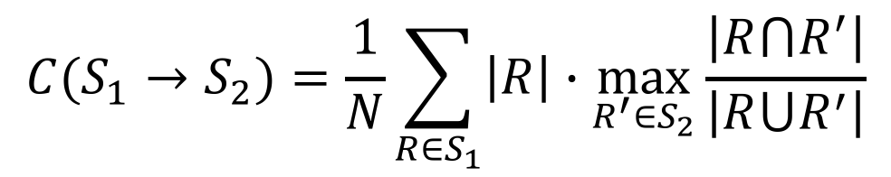
Segmentation Covering
It measures the similarity between segmentations by weight averaging the overlaps of regions in two segmentations.
$$C(S_{1}→S_{2})=\frac{1}{N}\sum_{R∈S_{1}}{\left|R\right|∙\max_{R^{′}∈S_{2}}{\frac{\left|R⋂R^{′}\right|}{\left|R⋃R^{′}\right|}}}$$

Slide 9
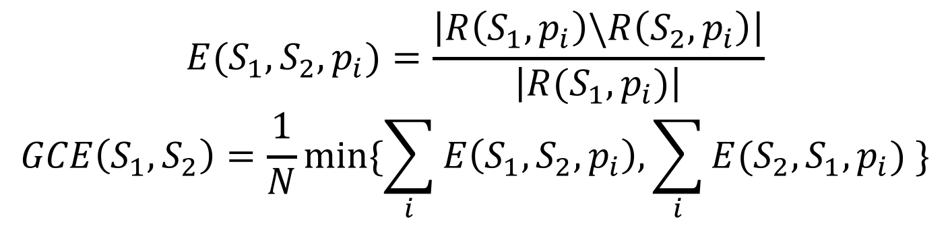
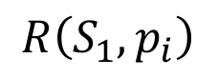
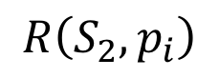
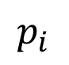
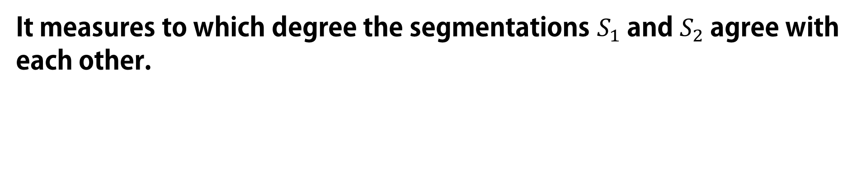
Global Consistency Error (GCE)
It measures to which degree the segmentations $S_{1}$ and $S_{2}$agree with each other.
$$E(S_{1},S_{2},p_{i})=\frac{\left|R\left(S_{1},p_{i}\right)\backslash R\left(S_{2},p_{i}\right)\right|}{\left|R(S_{1},p_{i})\right|}$$
$$GCE\left(S_{1},S_{2}\right)=\frac{1}{N}min⁡\{\sum_{i}{E\left(S_{1},S_{2},p_{i}\right),\sum_{i}{E(S_{2},S_{1},p_{i})} }\}$$
$$R\left(S_{1},p_{i}\right)$$
$$R\left(S_{2},p_{i}\right)$$
$$p_{i}$$

Slide 10
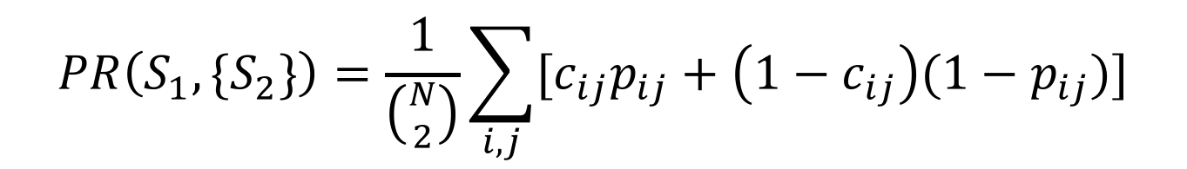
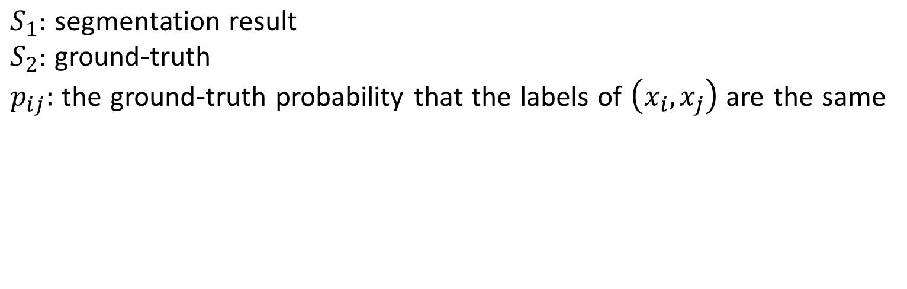
Probabilistic Rand (PR) index
It measures to which degree the segmentations $S_{1}$ and $S_{2}$agree with each other.
$$PR\left(S_{1},{\{S}_{2}\}\right)=\frac{1}{\left({N \atop 2}\right)}\sum_{i,j}{[c_{ij}p_{ij}+\left(1−c_{ij}\right){(1−p}_{ij})]}$$
$S_{1}\text{:} \text{segmentation} \text{result}$
$S_{2}$: ground-truth
$p_{ij}:$ the ground-truth probability that the labels of $\left(x_{i}, x_{j}\right)$ are the same

Slide 11
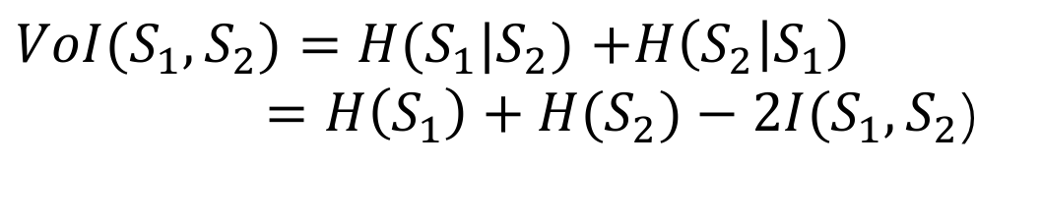
Variation of Information (VoI)
It measures the distance between two segmentations in terms of their average conditional entropy.
$VoI(S_{1},S_{2})=H(S_{1}|S_{2})$ $+H\left(S_{2} | S_{1}\right)$
$=H\left(S_{1}\right)+H(S_{2})−2I(S_{1},S_{2}$)

Slide 12
Variation of Information (VoI)
It measures the distance between two segmentations in terms of their average conditional entropy.
segmentation result
ground-truth
Abundance Information
segmentation result
ground-truth
limited information

Slide 13
Boundary Displacement Error (BDE)
It defines the error of one boundary pixel as the distance between the pixel and its closest pixel in the other boundary image.

Slide 14
Boundary Displacement Error (BDE)
It defines the error of one boundary pixel as the distance between the pixel and its closest pixel in the other boundary image.
ground-truth
segmentation result

Slide 15
Boundary Displacement Error (BDE)
It defines the error of one boundary pixel as the distance between the pixel and its closest pixel in the other boundary image.
ground-truth
ground-truth
segmentation result
segmentation result

Slide 16
Boundary Displacement Error (BDE)
It defines the error of one boundary pixel as the distance between the pixel and its closest pixel in the other boundary image.
ground-truth
ground-truth
segmentation result
segmentation result
better segmentation result

Slide 17
To Get High Quality of Segmentation
F-measure
Segmentation Covering
Probabilistic Rand (PR) index
Variation of Information (VI)
Global Consistency Error (GCE)
Boundary Displacement Error (BDE)

Slide 18



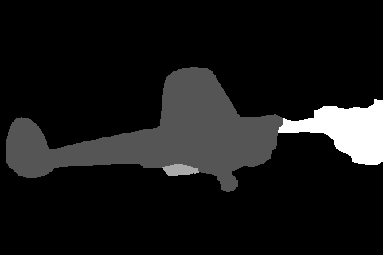




Original
Ground-truth
gPb-owt-ucm

Slide 19
Ground-truth
Evaluation result
Evaluation
Measure
Evaluation result
Mean
gPb-owt-ucm
Evaluation result
Final
Evaluation result
Evaluation result
Evaluation result
Evaluation result

Slide 20

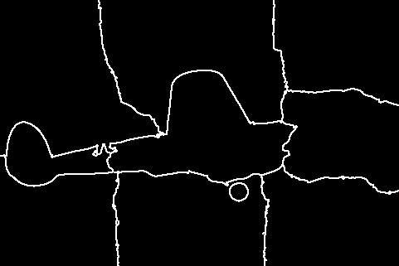
Examples
Original
Mean shift
gPb-owt-ucm
Normalized cut
BDE: 19.1901
PR: 0.60805
VoI: 10.492
GCE: 0.052159
BDE: 11.8276
PR: 0.86803
VoI: 1.0278
GCE: 0.10222
BDE: 13.5303
PR: 0.41775
VoI: 2.0725
GCE: 0.066417

Slide 21
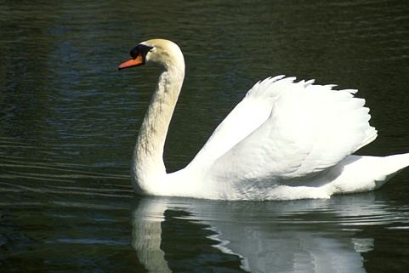


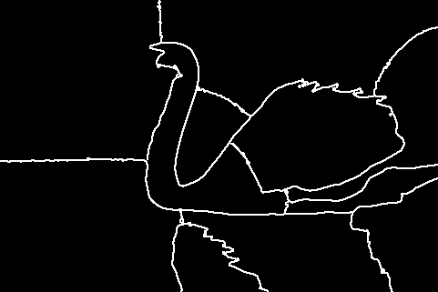
Examples
Original
Mean shift
gPb-owt-ucm
Normalized cut
BDE: 17.2482
PR: 0.66111
VoI: 10.2354
GCE: 0.050135
BDE: 12.7437
PR: 0.84461
VoI: 1.1124
GCE: 0.10237
BDE: 12.8711
PR: 0.3711
VoI: 2.3995
GCE: 0.067568

Slide 22



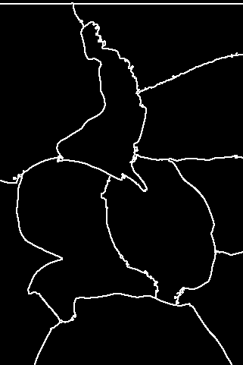
Examples
Original
Mean shift
gPb-owt-ucm
Normalized cut
BDE: 18.9191
PR: 0.62417
VOI: 10.5723
GCE: 0.051471
BDE: 11.9012
PR: 0.87111
VoI: 1.0349
GCE: 0.10537
BDE: 13.7155
PR: 0.40355
VoI: 2.1265
GCE: 0.067358

Slide 23
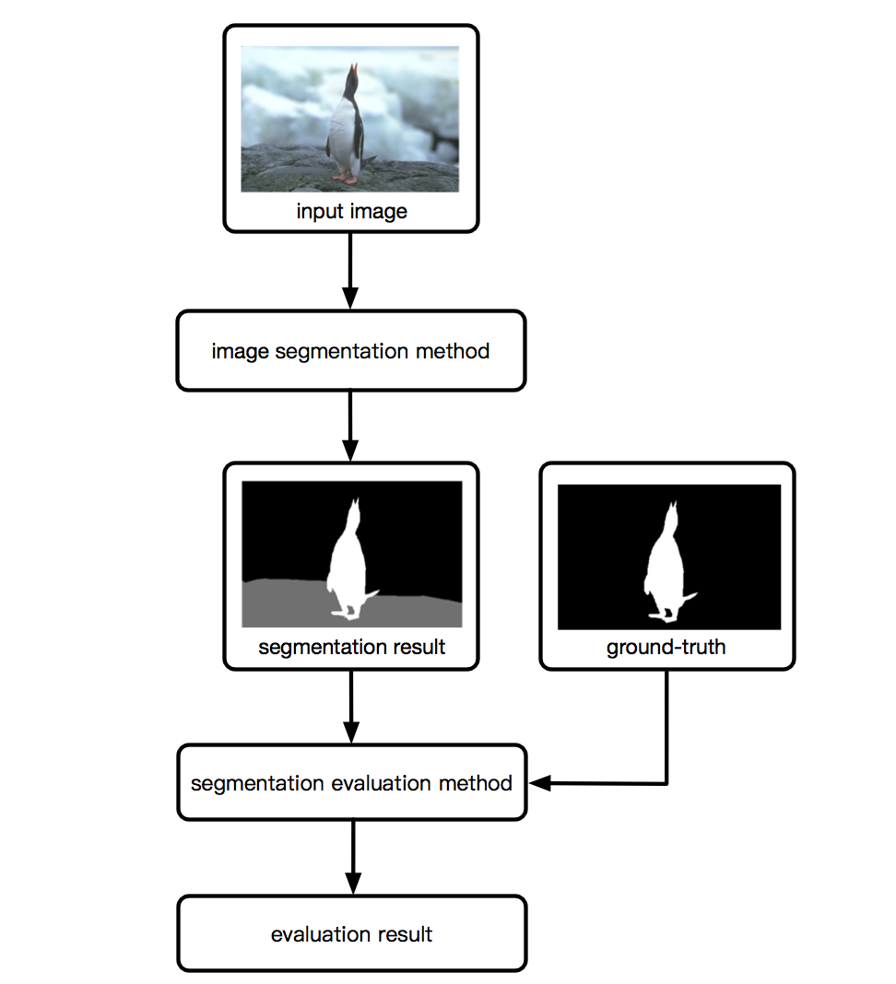
CV Assignment 1

Slide 24
Input images
Use test set of BSDS500 (includes 200 images)
test set
images
train set
validation set
BSDS500
ground-truth

Slide 25
Image segmentation methods
Implement at least five image segmentation methods

Slide 26
Image segmentation methods
Choose one segmentation method respectively from:
Threshold based image segmentation
Edge based image segmentation
Region based image segmentation
Select at least two approaches from:
Mean Shift
Normalized Cut
Efficient Graph-Based Image Segmentation
gPb-owt-ucm

Slide 27
Segmentation evaluation methods
Use at least three image segmentation measures from:
• F-measure • Segmentation Covering • Probabilistic Rand (PR) index
• Normalized Probabilistic Rand (NPR) index
• Variation of Information (VoI) • Global Consistency Error (GCE) • Boundary Displacement Error (BDE)
The final evaluation result of the dataset is the mean of all evaluation results.

Slide 28
CV Assignment 1
Due Date: April 24, 2017
Submission: 1. code
2. a report with your results and simple explanation
Zip all your files and submit your assignment to ouceecv@163.com

Slide 29
Thanks

